Slide 1

STAGE-1 THESIS EVALUATION
Transaction Foundation Models for General-Purpose
Financial Representation Learning
July 2026
Presented by
Hemang Ranga
CS25MTECH14005
Under the Guidance of
Prof. Sobhan Babu
Notes:
Good Afternoon. I’m Hemang Ranga, working under Prof. Sobhan Babu. I will be presenting on the topic “Transaction Foundation Models for General-Purpose Financial Representation Learning”

Slide 2

Motivation
Language
Vision
Transactions?
LLMs learn universal representations of text, reusable across many NLP tasks.
Vision foundation models learn universal representations of images.
Can we similarly learn universal representations of financial transactions?
Why is this hard?
Heterogeneous
Structured
Temporal
Event-based
Thesis goal: Learn a foundation model that produces general-purpose transaction embeddings, reusable across many downstream financial tasks.
Notes:
Large language models learn universal representations of text - one pretrained model, reused across translation, summarization, question answering, and more. Vision foundation models do the same for images. The motivating question for this thesis is: can we do the same for financial transactions - learn one pretrained representation that's reusable across many downstream financial tasks? This is hard because transaction data is heterogeneous - many fields with different semantics; structured, not free text; temporal, unfolding over a user's history; and event-based rather than linguistic. So the thesis goal is representation learning: build a foundation model that produces general-purpose transaction embeddings, not a model that's only good at one task like fraud detection.

Slide 3
Problem Statement
01 Reproduce: Understand and reproduce NVIDIA's Transaction Foundation Model.
02 Validate Transfer: Validate that learned transaction embeddings generalize across datasets.
03 Benchmark: Evaluate these embeddings on a downstream task — fraud detection is used as the benchmark.
04 Identify Gap: Identify limitations of current transaction representation learning.
05 Propose Extension: Propose an extension for richer, relationally-aware transaction representations.
FUTURE SCOPE
Notes:
Five objectives frame this thesis. First, understand and reproduce NVIDIA's Transaction Foundation Model. Second, validate that the embeddings it learns actually generalize across datasets, not just the one they were trained on. Third, evaluate these embeddings on a downstream task - and I want to be precise here - fraud detection is the benchmark I use, purely because labeled fraud data is available; it is not the research target. Fourth, identify limitations of current transaction representation learning based on what I find. And fifth, beyond Stage 1, propose an extension for richer, relationally-aware representations.

Slide 4
Evolution Toward General-Purpose Representations
Rule-Based
Features
Handcrafted
Features
Representation
Learning
Transformer
Representations
Foundation
Models
Manual thresholds
RF / XGBoost
Learned, not handcrafted
Contextual, sequence-aware
Pretrained once, reused everywhere
The evolution is a steady march toward increasingly general, reusable representations. Each stage removes an assumption the previous one relied on: hand tuning, task-specificity, and finally, single-dataset scope.
Notes:
The evolution of financial modelling has moved through five broad stages: rule-based features with manual thresholds; handcrafted features feeding classical ML like Random Forest and XGBoost; representation learning, where deep models start learning features rather than being handed them; transformer representations, which add contextual, sequence-aware attention; and finally foundation models, pretrained once and reused across many tasks. The point of this slide is that this is not an evolution toward a better fraud classifier - it's an evolution toward increasingly general and reusable representations.

Slide 5
Why Traditional ML / DL struggles
Traditional ML / DL
What Foundation Models Aim For
Transactions treated independently
Handcrafted, task-specific features
A new model trained per task
Weak long-range temporal modelling
Poor transferability across datasets
Self-supervised pretraining on raw sequences
General-purpose, reusable embeddings
One model, many downstream tasks
Strong long-range sequence modelling
Transfer across datasets and tasks
vs
Notes:
Traditional ML and DL approaches share a common weakness for our purposes: they treat transactions independently, rely on handcrafted, task-specific features, and require training a new model for every task. Even LSTMs, which model sequences, struggle with long-range dependencies, and none of these approaches transfer well across datasets. What we want instead is what foundation models aim for: self-supervised pretraining on raw sequences, producing general-purpose embeddings that one model can produce once and reuse across many downstream tasks, with strong long-range modelling and genuine transfer across datasets. This contrast is exactly why the field moved toward transformer-based foundation models for tabular and transaction data. [~0.75 min]

Slide 6
Literature — Paper 1: TabNet
Purpose: Bring deep learning to tabular data, before transformer architectures existed for this domain.
Key Contribution
Limitation
Sequential attention selects relevant features per instance
Learns instance-wise feature importance end-to-end
Learns task-specific representations, trained end-to-end per task
No reusable pretraining objective — not a foundation model
Notes:
TabNet is included briefly, as a stepping stone. Its purpose was to bring deep learning to tabular data before transformer architectures existed for this domain. Its key contribution is a sequential attention mechanism that selects relevant features per instance, learning feature importance end-to-end rather than through hand-engineering. But it's still trained end-to-end for one task at a time - there's no pretraining objective that produces a reusable representation. It's a deep learning model for tabular data, not a foundation model. [~0.6 min]

Slide 7
Literature — Paper 2: IBM TabFormer
Field-Level
Tokens
Hierarchical
TabBERT
Row-Level
Embedding
Model
→
→
→
Concepts introduced: TabFormer, Hierarchical TabBERT, TabGPT — hierarchical tokenization (field → row) and sequential representation learning via masked language modelling on transaction tables.
Limitation: While TabFormer introduced self-supervised pretraining for transaction sequences, it was not explicitly designed or evaluated as a general-purpose transaction foundation model supporting broad transfer across multiple downstream tasks.
Notes:
IBM's TabFormer paper is the more central piece of literature. It introduces TabFormer, hierarchical TabBERT, and TabGPT - the key idea being hierarchical tokenization, first at the field level and then at the row level, combined with sequential representation learning through masked or causal language modelling on transaction tables. This is an important step - it shows transformers can meaningfully model transaction sequences. But its limitation, for our purposes, is that it still learns task-specific representations rather than true foundation embeddings - pretraining exists, but the representation isn't positioned or evaluated as something generally reusable across many downstream financial tasks. That's the gap NVIDIA's work steps into. [~0.85 min]

Slide 8
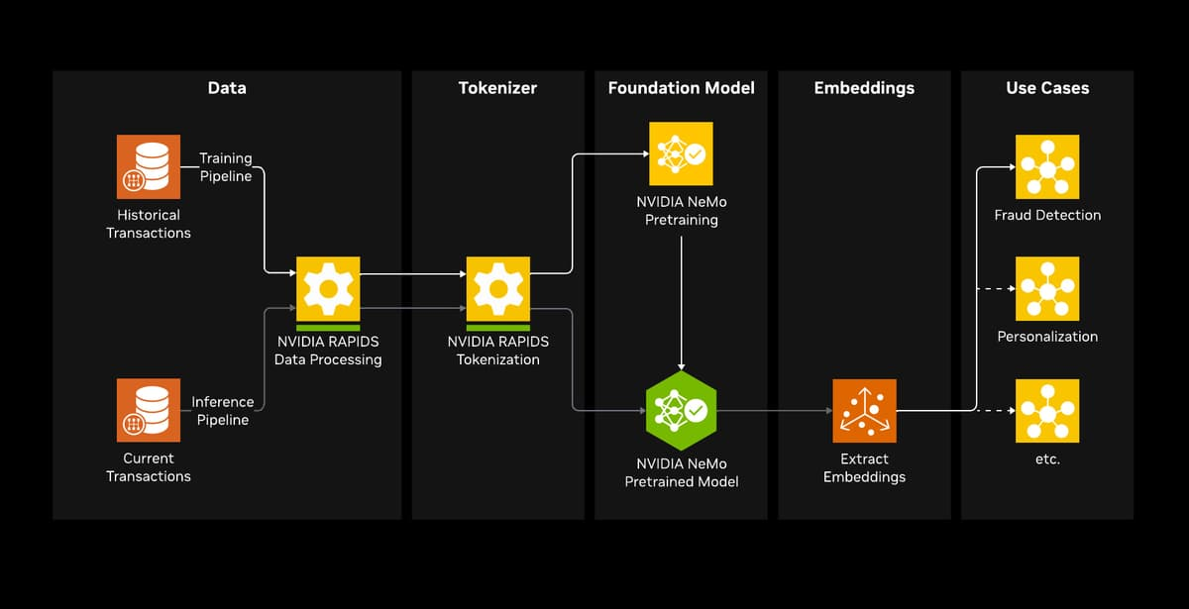
Literature — Paper 3: NVIDIA TFM
Self-supervised: predicts the next transaction token — no task labels used during pretraining
The embedding produced is task-agnostic by design, meant to be reused across fraud detection, credit risk, segmentation, and more
Notes:
This is the primary paper my implementation builds on. The pipeline is: a financial tokenizer converts each transaction into semantic tokens; a decoder-only transformer is pretrained with causal language modelling, predicting the next transaction token; once trained, we extract embeddings from the frozen model; and the result is a set of reusable transaction embeddings, intended for general downstream tasks - not one task. Critically, no task labels are used anywhere in pretraining - the model learns purely from the structure of transaction behaviour. This architecture forms the basis of my implementation, which I'll walk through in detail next. [~1.25 min]

Slide 9
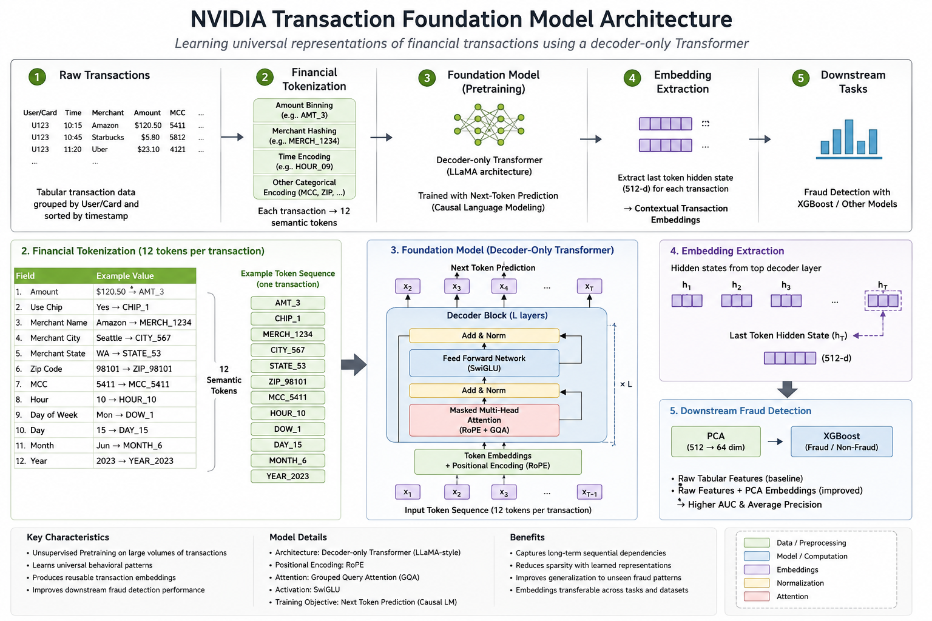
Implementation Reference: NVIDIA Architecture
Notes:
Here's the full architecture I implemented. Raw transactions go through Financial Tokenization - a FinancialTabularTokenizer converts every transaction into twelve semantic tokens: amount, merchant, MCC, hour, day, ZIP, and so on, with amounts log-bucketed, merchant IDs hashed, and temporal fields discretized. Transactions are grouped chronologically by user or card, and a decoder-only transformer - LLaMA-style, with rotary position embeddings, grouped-query attention, and SwiGLU - is trained self-supervised, predicting the next transaction token, with no task labels involved. Once trained, the model is frozen, and the hidden state at the final transaction token is extracted as a 512-dimensional embedding per transaction - this is the general-purpose representation. Only at the very end, for evaluation purposes, is this embedding handed to a downstream classifier. [~2.0 min]

Slide 10
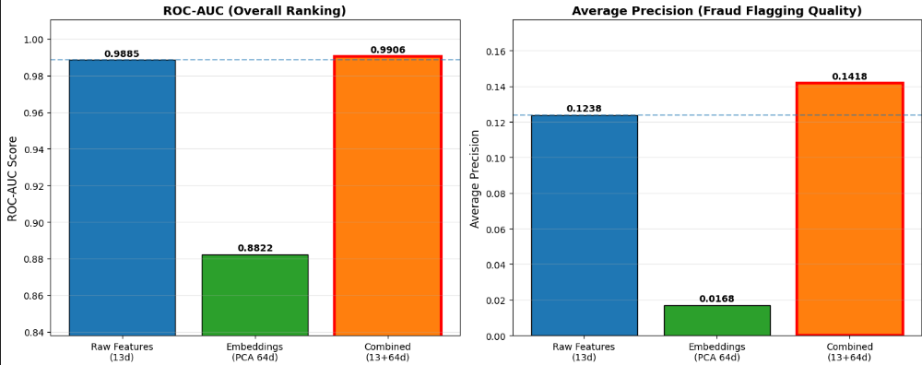
Implementation & Embedding Evaluation — Original Data
Implemented the complete 5-notebook pipeline end-to-end
Foundation model trained from scratch, purely self-supervised (no labels)
To evaluate embedding quality, fraud detection is used as the benchmark task — chosen because labelled data is available
Compared three feature sets fed to a downstream classifier:
  Raw tabular features (baseline)
  Embeddings only (PCA 64-d)
  Combined: raw + embeddings
Combined beating both alone is evidence the embeddings hold complementary signal.
0.9906
+14.5%
Combined ROC-AUC
AP Lift vs Baseline
Notes:
I implemented the full five-notebook pipeline end-to-end: tokenization, foundation model training from scratch - purely self-supervised, no labels involved - embedding extraction, and evaluation. Now, to actually evaluate whether these embeddings are any good, I need some downstream task with ground truth, and I used fraud detection for that, simply because labelled data is available. I compared three feature sets going into a downstream classifier: raw tabular features, embeddings alone, and the combination. Raw features alone reach 0.9885 ROC-AUC; embeddings alone are weaker on their own - about 0.8822; but combined, we get 0.9906 AUC and a 14.5% lift in average precision over baseline. The point isn't that I built a better fraud model - it's that the embeddings clearly carry complementary signal beyond what raw features already capture, which is exactly the evidence we want for representation quality. [~1.5 min]

Slide 11
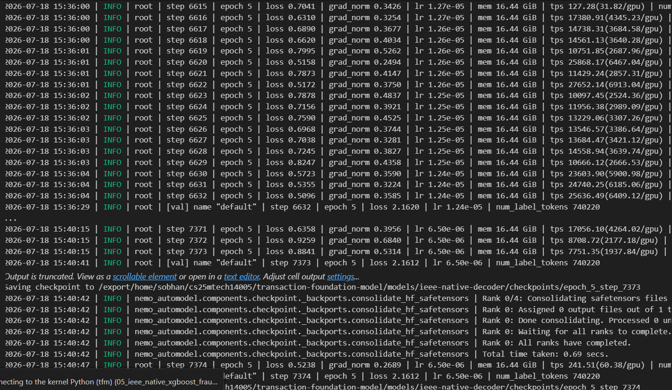
Testing Generalization: A Structurally Different Dataset
IEEE-CIS Raw Schema
Adaptation Pipeline
NVIDIA Expected Schema
1. Temporal reconstruction
2. Feature mapping to 12-field schema
3. Chronological splitting
No explicit user / card ID
400+ columns, unfamiliar schema
Relative time deltas, not timestamps
12-field tokenizer schema
Chronologically grouped by pseudo-entity
→
→
Goal: test whether the representation-learning approach — not a fraud-specific model — transfers to a new, structurally different dataset.
Trained from scratch on IEEE-CIS: ~472K-row subset, 5 epochs (7,375 steps) — enough to validate the pipeline end-to-end, though limited in scale.
Training log (Notebook 3, IEEE-CIS) — step 7,373/7,373, checkpoint saved
Notes:
To test generalization, I adapted the IEEE-CIS fraud detection dataset - chosen because its schema is completely different from the original: no explicit user or card IDs, 400+ unfamiliar columns, different temporal representation. My contribution was a schema-adaptation pipeline - identifier engineering, temporal reconstruction, feature mapping onto NVIDIA's 12-field schema, and chronological splitting - all without touching NVIDIA's tokenizer or model code. The goal here is not to build a fraud model for IEEE-CIS - it's to test whether the representation-learning approach itself transfers to a structurally different dataset. I trained the foundation model from scratch on a roughly 472,000-row subset, 5 epochs - enough to validate the pipeline end-to-end, though limited in scale. [~1.1 min]

Slide 12
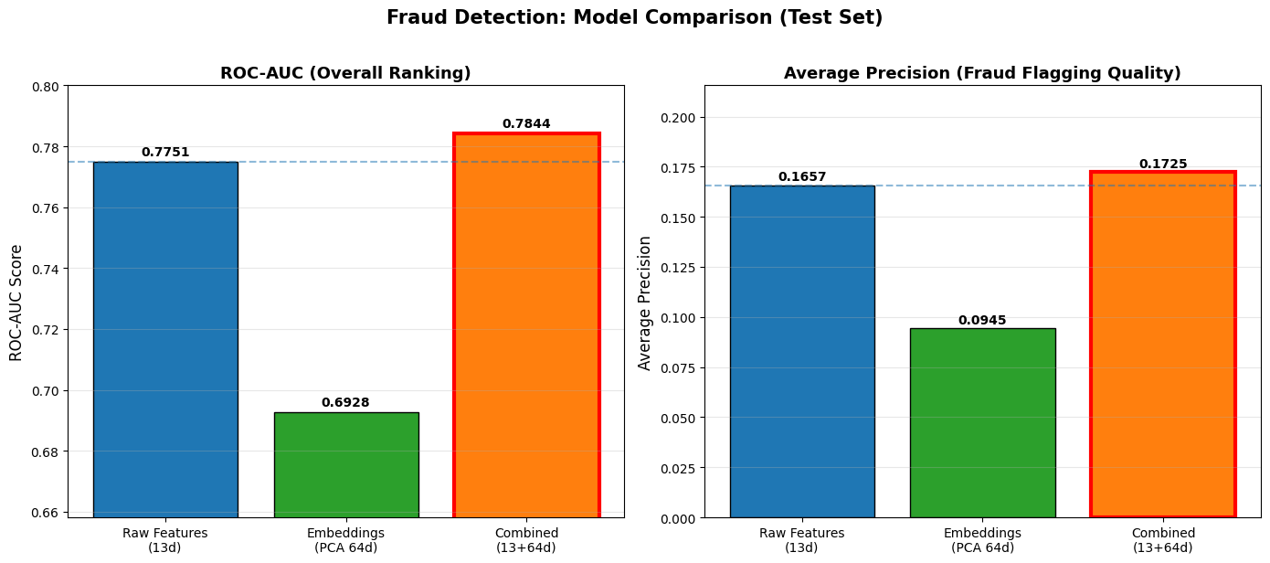
Generalization Evidence — IEEE-CIS Benchmark
Same benchmark protocol as Phase 1: Raw / Embeddings-only / Combined
Same ordering holds: Embeddings-only < Baseline < Combined
Raw (13d): 0.7751 ROC-AUC, 0.1657 AP
  Embeddings-only (64d): 0.6928 ROC-AUC, 0.0945 AP
  Combined (77d): 0.7844 ROC-AUC, 0.1725 AP
Smaller lift than Phase 1 (4.06% vs 14.5% AP) — expected, given a small subset and only 5 epochs of pretraining
0.7844
+4.06%
Combined ROC-AUC
AP Lift vs Baseline
Same pattern replicates on a new dataset: embeddings carry transferable, complementary signal
Notes:
On IEEE-CIS, the same evaluation protocol gives: raw features 0.7751 AUC and 0.1657 average precision; embeddings alone weaker at 0.6928 AUC and 0.0945 AP; combined again best, at 0.7844 AUC and 0.1725 AP - a 4.06% AP lift. That lift is smaller than the 14.5% we saw on the original dataset, which makes sense given this model saw a small subset for only 5 epochs. But the important read here is not 'how good is fraud detection on IEEE-CIS' - it's that the same pattern - embeddings-only weakest, combined best - replicates on a completely different dataset, which is exactly the evidence we want for generalization of the representation-learning approach. [~1.1 min]

Slide 13
Research Gap: What's Missing From the Representation
Captured: Temporal & Sequential
Missing: Relational Structure
A transaction history modelled as an ordered sequence per account
Accounts, merchants & companies connected through shared transactions
This is a limitation of the representation itself, not of any one downstream task — it affects fraud detection, AML, credit risk, and recommendation alike, since all of them would build on these same embeddings.
Notes:
Current transaction foundation models - including the one I implemented - learn temporal behaviour, sequential dependencies, and behavioural context, all scoped to a single account or card. But financial ecosystems also contain relational information: account networks, merchant networks, company networks, invoice chains, customer-merchant interactions. None of that is captured by a purely sequential representation. And I want to stress - this is a limitation of the representation itself, not of the fraud detection task specifically. It would affect any downstream task built on these embeddings: fraud detection, anti-money-laundering, credit risk, recommendation, all of it. [~1.1 min]

Slide 14
Proposed Future Work
Transaction
Sequences
Financial
Tokenizer
Decoder Foundation
Model
Transaction
Embeddings
→
→
→
↓
Graph
Construction
Graph Representational Learning
(GCN, GNN, GAT)
Relational Transaction
Embeddings
→
→
Enriches multiple downstream tasks:
Fraud Detection
AML
Credit Risk
Customer Segmentation
Recommendation
Transaction Classification
The Graph enriches the learned transaction representation — it does not replace the downstream classifier. This is a research hypothesis for Stage 2.
Notes:
Here's the proposed extension. The proven part of the pipeline - transaction sequences through the financial tokenizer into the decoder foundation model, producing transaction embeddings - stays exactly as is. What I'm proposing to add, in dashed boxes because this is future work, is: construct a graph over transacting entities, apply a graph neural network, and produce relational transaction embeddings. The key point is that this enriches the representation - it doesn't replace the downstream classifier, and it doesn't target fraud detection specifically. These enriched embeddings could feed fraud detection, anti-money-laundering, credit risk, customer segmentation, recommendation, or transaction classification - any task that benefits from knowing how entities relate to each other. I want to be clear this is a research hypothesis for Stage 2, not a completed contribution. [~1.1 min]

Slide 15
Conclusion
Reproduced and generalized NVIDIA's Transaction Foundation Model
Demonstrated that learned transaction representations transfer across datasets
Identified an important limitation in current transaction representation learning — missing relational structure
Propose enriching these representations with relational information (Stage 2 hypothesis)
Stage 1
Stage 2
Stage 3
Notes:
To summarize: I reproduced and generalized NVIDIA's Transaction Foundation Model; I demonstrated that the learned transaction representations transfer across datasets; I identified an important limitation in current transaction representation learning - the absence of relational structure; and I propose enriching these representations with relational information as a Stage 2 hypothesis. Throughout this talk, fraud detection was the benchmark, not the goal - the contribution is a general-purpose transaction representation, evaluated through one convenient downstream lens. Thank you, I'm happy to take questions. [~0.6 min]

Slide 16
Thank You!

